Slide 1
Welcome to
Curriculum Night!
7th/8th Grade 2022-2023

Slide 2
7th Grade Cheat Sheet: Who’s Who
Mrs. Siemer-Math
p.siemer@stgabeschool.org
Mr. Blessing-7B homeroom, Science and Social Studies
a.blessing@stgabeschool.org
Ms. Timme-7S homeroom, Reading, English, Religion
b.timme@stgabeschool.org

Slide 3
Meet Mr. Blessing
-it is my third year of teaching 7th/8th grade science and second year of teaching 7th grade Social Studies..
-I graduated with a Masters in Education in 2020 and my licensure goes from grades 7-12. This makes me uniquely prepared to help students get ready for high school.
-A few of my hobbies include cooking, hiking, and gardening.

Slide 4
Contact Information
Email: a.blessing@stgabeschool.org.
I generally check my email around two to three times a day. Once in the morning, once in the evening, and then once when I go to bed. It is imperative for any emails to specify precisely what is going on, so I can do my best to help alleviate the problem.
Do not leave me a message for a change of plans for that day’s dismissal. Please contact the front office if your son/daughter has to go to an appointment for the doctor or is scheduled to be released early for whatever reason.

Slide 5
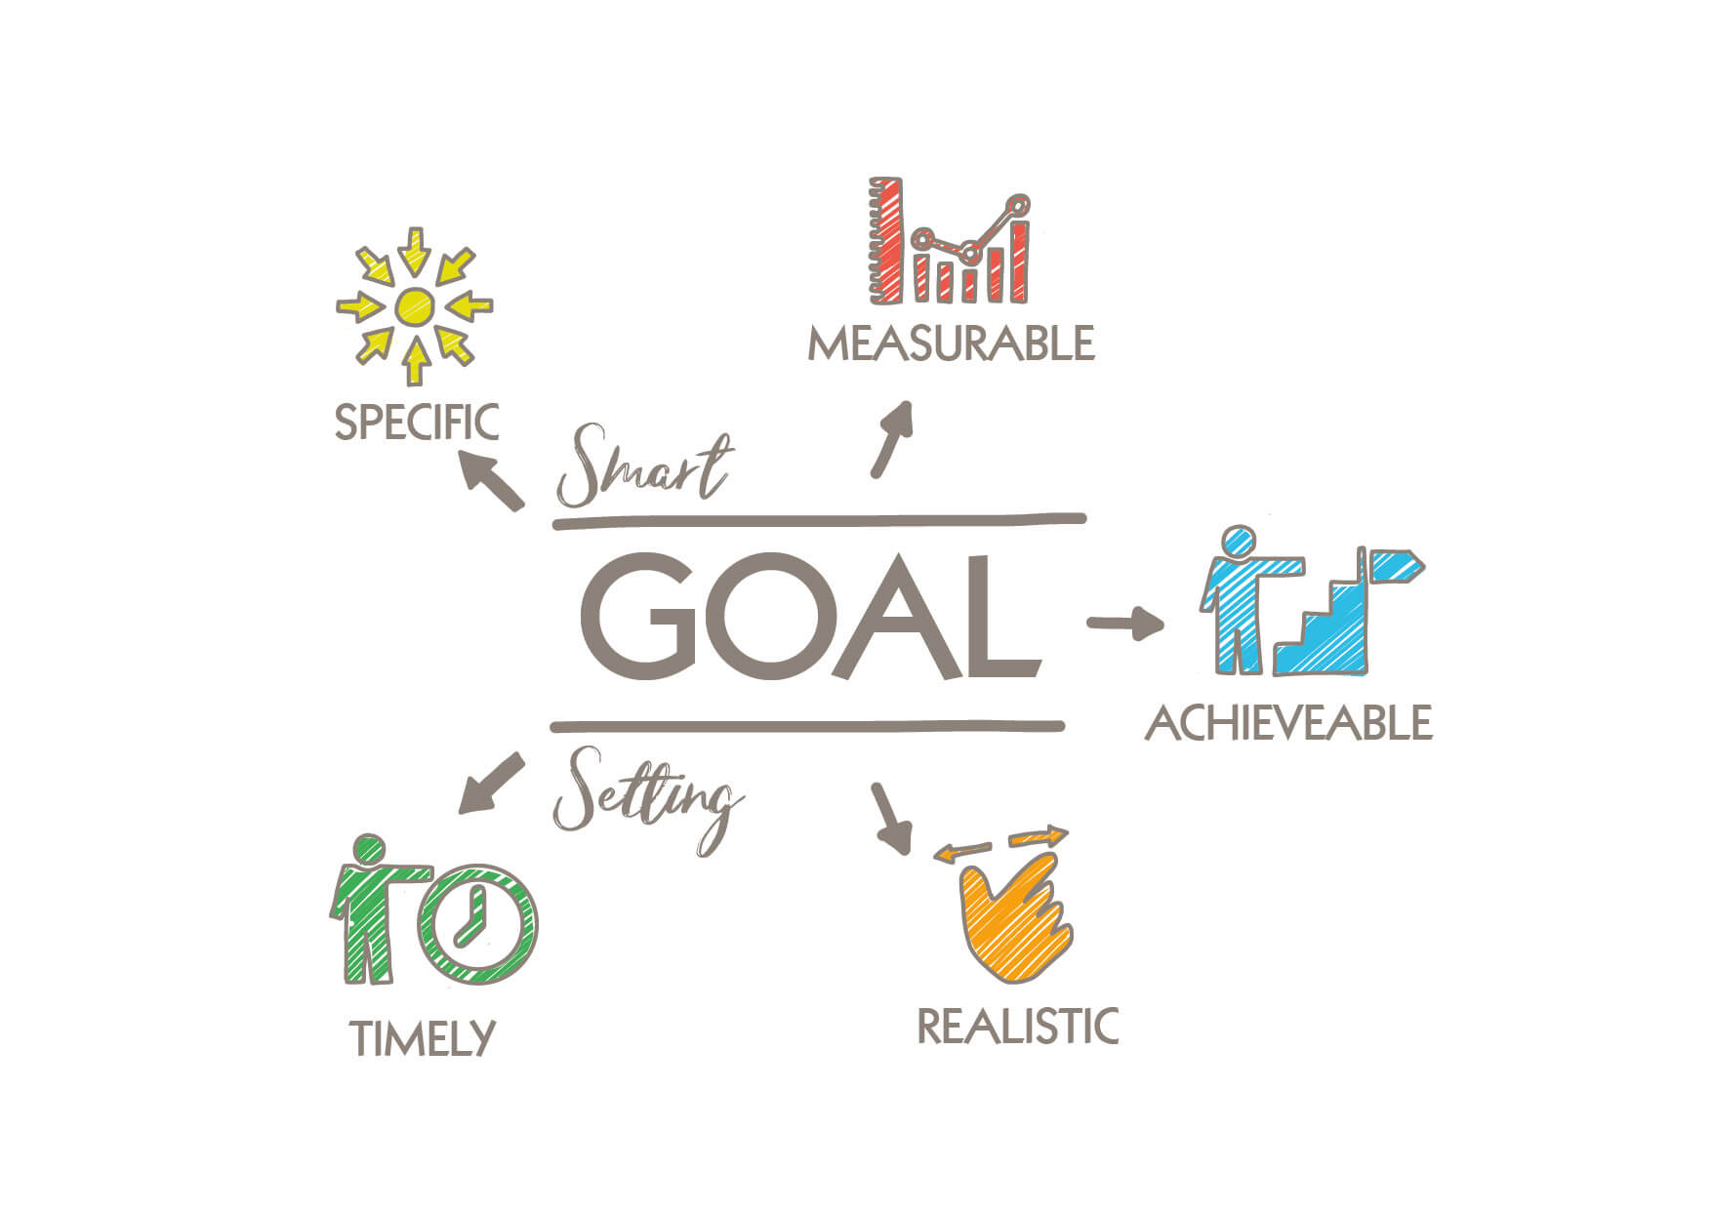
Expectations
It is my expectation for students to be kind and prepared to enter the classroom. As junior high teacher, it is our job to prepare them for high school where the expectations for them will be much higher. I hope to have a great year and I am looking forward to the growth of every student.

Slide 6
7th Grade Interactive Science
7th Grade- The first trimester
scientific method, changes of state/phase changes, mixtures, and ph scale
The second trimester covers chemistry, which includes how to read periodic table, organizing the elements, and different type of bonds. We leave balancing chemical equations to 8th grade. We also cover waves and thermal energy as well.
- The third trimester will cover astronomy, weather, and water and if any time is leftover, I will cover speed and motion to help prepare them for 8th grade physics

Slide 7
8th Grade Interactive Science
First Trimester-Covers the basics behind how to conduct a scientific experiment, but goes into further detail in how to distinguish bias in experiments and theories. Part two covers fossils, geological time scale, volcanoes, and erosion. Towards the end of the first trimester, the first actual bits of material we begin is Electromagnetism. Project: Egg Drop
Second Trimester-The second trimester focuses mostly on the basics of physics, force, and motion. During this chapter, we will discuss Newton’s laws of motion. It should align well with the algebrae they are learning in Math. Project: Roller Coaster
Third Trimester-will focus on genetics and chemistry. Here, they will learn how to balance chemical equations and learn how traits are passed on.

Slide 8
7th Grade Social Studies
-7th grade Social Studies is broken up into multiple small units and is designed to follow the Archdiocese’s standards incredibly closely. Here is what we are covering in each trimester
1st Trimester: Ancient Greece and Rome, Feudalism, Medieval period.
2nd Trimester: Renaissance, Middle eastern trade, Reformation, Beginnings of the Americas
3rd Trimester: Colonialism and the start of European trade with Americas, American Revolution. We will end at the war of 1812.

Slide 9
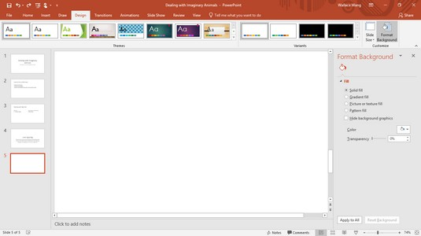
Technology in the Classroom
Discuss the proper use of ipads with your child-it is a learning TOOL, not a toy. Technology can be a useful work tool, and our focus is to teach them how to use it to work efficiently.
The school ipad should be used ONLY for school work.
Review the “Responsible Use of Technology” policy with your child.
Your child must bring his/her ipad, fully charged, to school each day. We will not use it for all assignments, but it should be ready when we need it.
We will use Google Classroom as our platform for assignments.
Your child should NOT bring other devices to class-no smart watches are allowed, and phones must remain IN bookbags and be OFF.

Slide 10
Google Classroom
Assignments on GC are due in the same way that handwritten assignments are due; they must be complete, follow directions, and turned in on time in order to earn full credit.

Slide 11
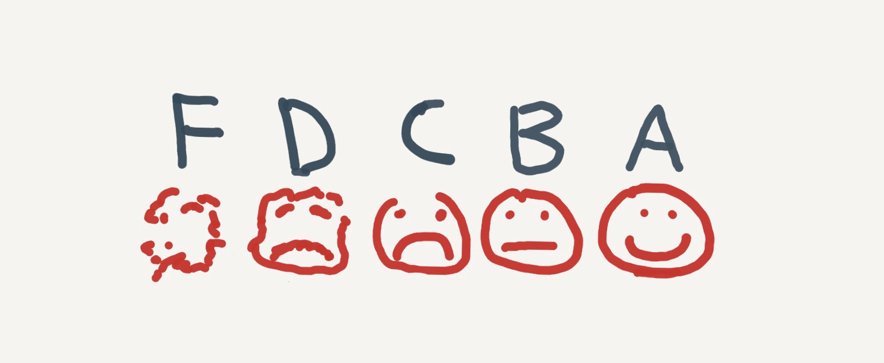
Grading
For all of my classes, I use a point system to mark grades. At the end of the quarter, the points are tallied up and the grade is based on how many points you earned out of how many total points worth of assignments we had.
Tests are worth around 30-50 points, homework is worth 3-5, quizzes are worth 10, and projects are worth around 30 to 50. The lowest quiz grade will be dropped at the end of the trimester. Extra credit opportunities will be given throughout the trimester

Slide 12
To Do List:
Please make sure your child has a non-metal water bottle that closes tightly-we are only using water fountains as bottle fillers.
Please make sure your child wears deodorant each day. Thank you!
Please make sure your child’s belongings are labeled-jackets, sweatshirts, pencils, etc.
Please let your child be accountable for their own actions and consequences of his/her actions.
Please remind your child to ask for help when he/she needs it!
Please be on time for school and for dismissal-remember that school hours are 8 am-2:45 pm. We start school at 8 am and students are to be ready to start their day at that time, not walking into the room at 8 am. We must see you in order to release your child to you at the end of the day. If you are not there, you need to report to the office to pick up your child.
THANK YOU for your support and for encouraging your child to be excited about 7th grade!

